Slide 1
GLOBAL WEATHER DATA ANALYSIS
Presented by:
M. SRI SARANYA

Slide 2
INTRODUCTION
Weather data plays an important role in understanding climate patterns across different regions.
This project focuses on analyzing global weather conditions.
It includes key factors like temperature, humidity, wind speed, and precipitation.
The analysis is performed using Power BI to create interactive visualizations.
Helps in identifying trends and comparisons across countries and locations.

Slide 3
PROBLEM STATEMENT
Weather data is large and complex to analyze manually
It is difficult to identify patterns across different countries and locations
Comparing temperature, humidity, wind speed, and precipitation is challenging
There is a need for a visual and interactive approach to simplify analysis

Slide 4
BUSINESS PROBLEM
Which country has the highest average temperature?
Which locations have the highest average humidity levels?
Which countries experience the highest wind speeds?
Which country records the highest total rainfall (precipitation)?
Which locations have the highest temperature?
What is the percentage distribution of humidity by country?
How does wind speed vary across different locations?
How does precipitation differ between locations?

Slide 5
DATA OVERVIEW
Weather ID – Unique identifier (Primary Key)
Country – Name of the country
Location Name – City or station
Latitude – Geographic latitude
Longitude – Geographic longitude
Temperature Celsius – Temperature in °C
Humidity – Relative humidity (%)
Wind kph – Wind speed in kph
Last updated –Data and time
Precip mm – Rainfall in mm

Slide 6
TECHNOLOGY USED
Data Source / Collection:
Global Weather API / Open Data CSV
Data Cleaning & Preparation:
Power Query in Power BI (for cleaning missing values and formatting data)
Data Modelling & Analysis:
Power BI (creating dimensional tables, KPIs, and measures)
DAX (for calculations like Average Temperature, Total Precipitation)
Data Visualization:
Power BI Charts: Bar Chart, Column Chart, Cards, Slicers, line chart.

Slide 7
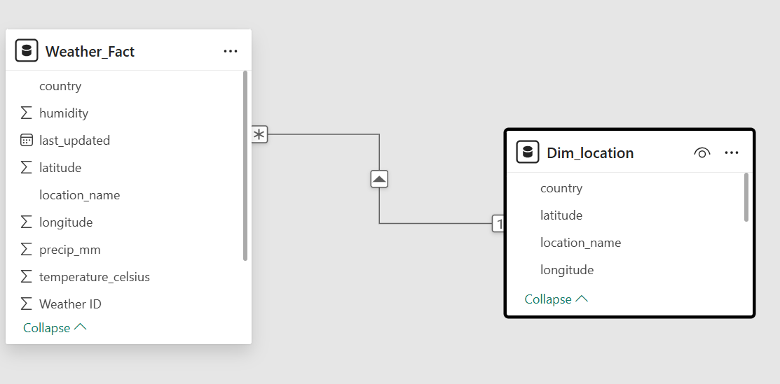
DATA MODELLING

Slide 8
KPI (KEY PERFORMANCE INDICATORS)
Average Temperature (°C) Measure: = AVERAGE('Weather fact'[Temperature_Celsius]) Visual Idea: Card visual or Bar Chart showing the average temperature per country Insight: Shows the typical temperature across locations.
Highest Temperature Recorded Measure: = MAX('Weather fact'[Temperature_Celsius]) Visual Idea: Card visual or Column Chart showing the highest temperature per location or country Insight: Highlights the hottest location or country in the dataset
)
Average Humidity Level (%) Measure: = AVERAGE('Weather fact'[Humidity])
Visual Idea: Card visual or Column Chart showing average humidity by location or country
Insight: Identifies areas with high humidity levels

Slide 9
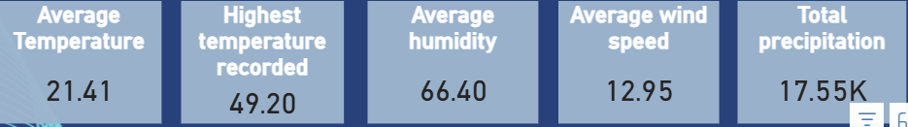
Average Wind Speed (kph) Measure:= AVERAGE('Weather fact'[Wind_kph])
Visual Idea: Card visual or Column Chart showing average wind speed by location or country
Insight: Highlights regions with strong winds
Total Precipitation (mm) Measure: = SUM('Weather fact'[Precip_mm])
Visual Idea: Card visual or Column Chart showing total rainfall by location or country
Insight: Shows regions with the most rainfall and compares precipitation across locations

Slide 10
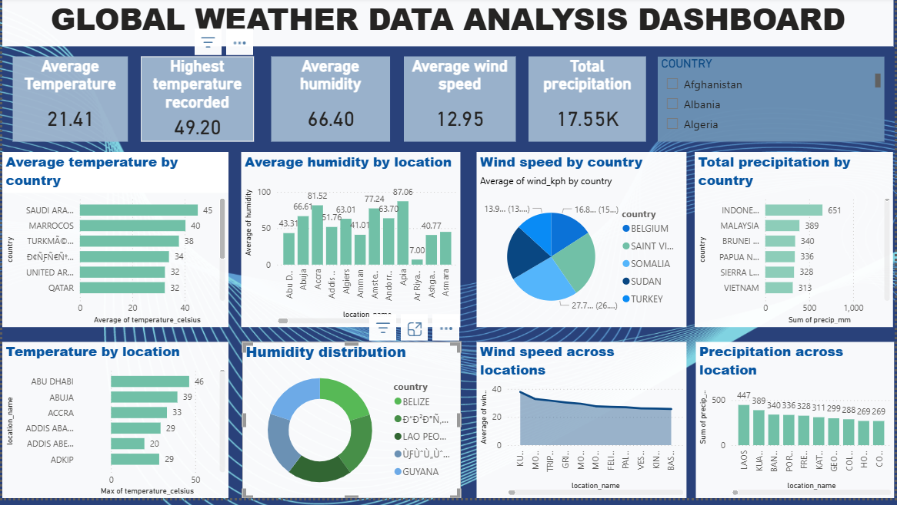
DASHBOARD OVERVIEW

Slide 11
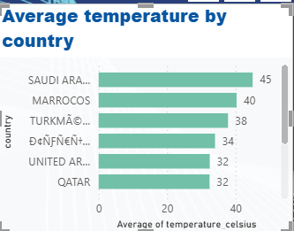
GLOBAL WEATHER ANALYSIS
Chart Question 1
Which country has the highest average temperature?
Chart Type: Bar Chart X-axis: Country Y-axis: Average Temperature (°C) Insight: Highlights the hottest countries globally

Slide 12
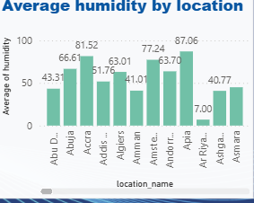
Chart Question 2
Which locations have the highest average humidity levels?
Chart Type: Column Chart X-axis: Location Name Y-axis: Average Humidity Insight: Identifies areas with high humidity across locations

Slide 13
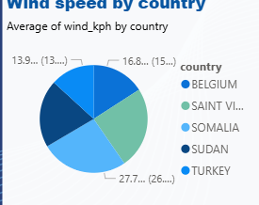
Chart Question 3
Which countries experience the highest wind speeds?
Chart Type: Bar Chart
X-axis: Country
Y-axis: Average Wind Speed (kph)
Insight: Highlights countries with strong wind conditions

Slide 14
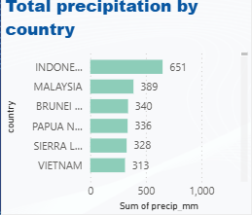
Chart Question 4
Which country records the highest total rainfall (precipitation)?
Chart Type: Bar Chart
X-axis: Country
Y-axis: Total Precipitation (mm)
Insight: Identifies countries with the highest rainfall levels

Slide 15
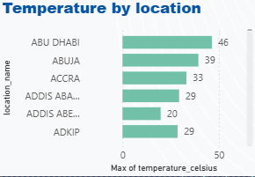
Chart Question 5
Which locations have the highest temperature?
Chart Type: Column Chart
X-axis: Location Name
Y-axis: Maximum Temperature (°C)
Insight: Identifies locations with the highest recorded temperatures

Slide 16
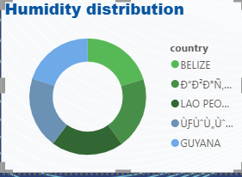
Chart Question 6
What is the percentage distribution of humidity by country?
Chart Type: Pie Chart / Donut Chart
X-axis: Country
Y-axis: Average Humidity (%)
Insight: Shows how humidity is distributed across countries

Slide 17
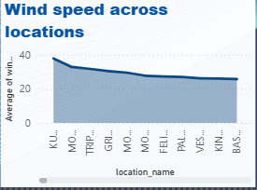
Chart Question 7
How does wind speed vary across different locations?
Chart Type: Column Chart
X-axis: Location Name
Y-axis: Average Wind Speed (kph)
Insight: Shows variation in wind speed across locations

Slide 18
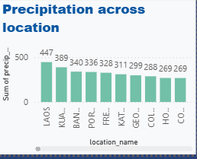
Chart Question 8
How does precipitation differ between locations?
Chart Type: Column Chart
X-axis: Location Name
Y-axis: Total Precipitation (mm)
Insight: Compares rainfall levels across different locations

Slide 19
conclusion
This project provided valuable insights into global weather patterns by analyzing key metrics such as temperature, humidity, wind speed, and precipitation. The dashboard effectively highlights variations across countries and locations, helping to identify trends and extreme conditions.
Overall, the analysis demonstrates the importance of data-driven visualization in understanding weather behavior and supporting better decision-making.

Slide 20
THANK YOU

